Slide 1
BIO ENERGY
Photosynthesis - Biogas Generation

Slide 2
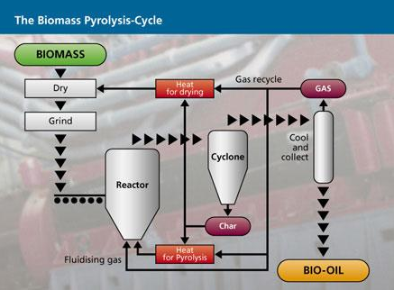
Pyrolysis:

Slide 3
Pyrolysis
Biomass can be converted into gases, liquids and solids through Pyrolysis at temperatures of 500-1000⁰C by heating in a closed vessel in the absence of oxygen.
Pyrolytic destructive distillation wood used to recover methanol, acetic acid, turpentine and charcoal.
It can process all forms of organic materials, including rubber and plastics.
The gases produced are a mixture of nitrogen, methane, carbondioxide, carbon monoxide and other hydrocarbons.
Liquid produced are oil like materials and
Solid are similar to charcoal.

Slide 4
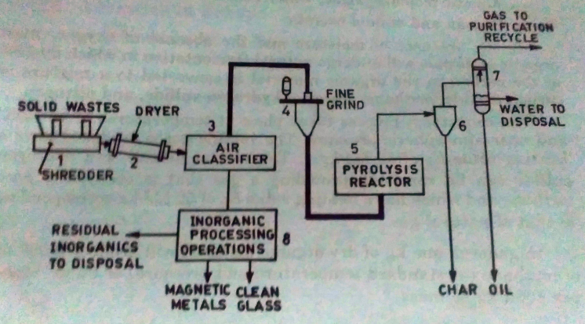
Pyrolysis

Slide 5
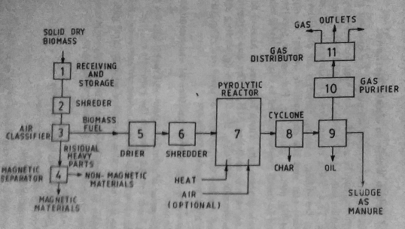
Pyrolysis -Urban waste

Slide 6
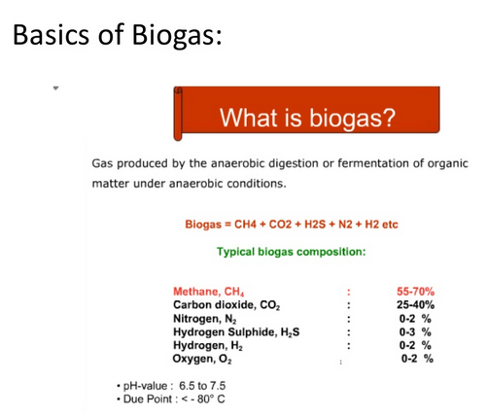

Slide 7
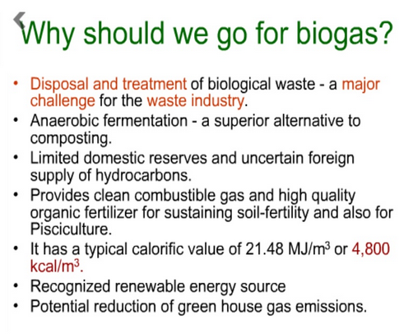

Slide 8
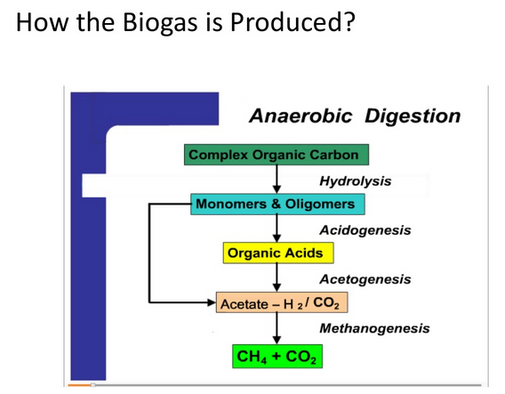

Slide 9
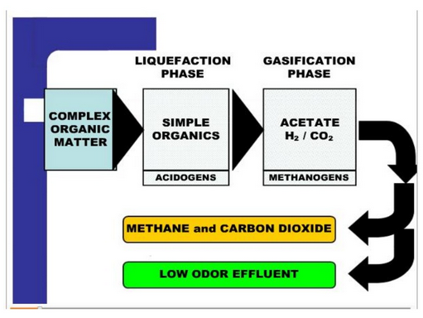

Slide 10
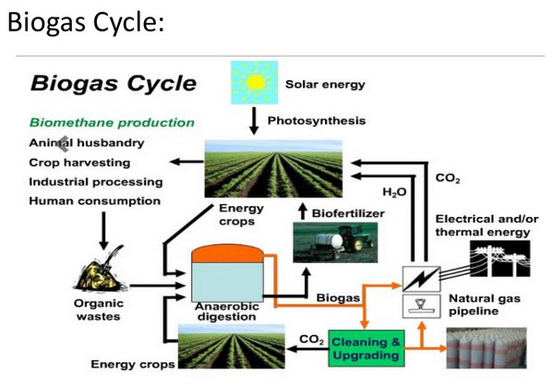

Slide 11
Biogas generation:
Biogas or ‘Gobar gas’(mainly cow dung)-Produced from the decomposition of animal, plant and human waste.(piggery waste, poultry droppings-effectively used , algae, crop residues, garbage kitchen waste, paper wastes, sea food, waste from sugarcane refinery, water hyacinth etc., )
All cellulosic organic material of animal or plant origin-easily biodegradable-potential raw material for biogas production.
50-60% methane 30-40% carbon dioxide and impurities likeH2,H2S and N2.
Slow burning gas ,calorific value-5000-5500 kcal/kg
Used directly in cooking, retains its value as a fertilizer and returned to soil.
Biogas –produced by digestion, pyrolysis or hydro gasification.

Slide 12
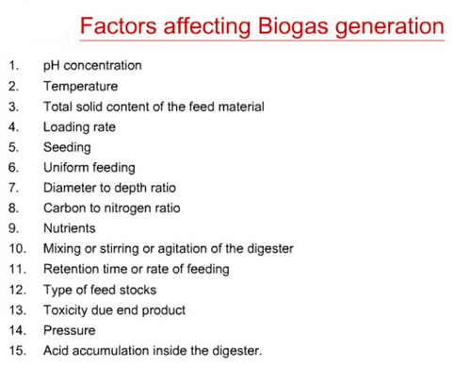

Slide 13
Classification of biogas plants
Biogas plants are broadly classified as
Continuous and batch types-as per the process.
Dome and drum type-shape
Different types of drum type

Slide 14
Continuous plant
Continuous plants are fed and emptied continuously.
They empty automatically through the overflow whenever new material is filled in. Therefore, the substrate must be fluid and homogeneous.
Continuous plants are suitable for rural households as the necessary work fits well into the daily routine.
Gas production is constant, and higher than in batch plants. Today, nearly all biogas plants are operating on a continuous mode.

Slide 15
Continuous plant:
Single digester
Raw material charged regularly and the process goes on without interruption except for repair and cleaning
Raw material is self buffered- thoroughly mixed with the digesting mass, where dilution prevents souring and biogas production is maintained.
Continuous process may be completed in a single stage or separated into two stages.
Single stage process
Double stage process

Slide 16
Single stage process
Digestion of waste materials in a single chamber or digester is called single stage process, in two chambers or digester is called multi stage process.
Entire process of conversion of complex organic compounds into biogas is completed in a single chamber.
Chamber is regularly fed with the raw materials while the spent residue keeps moving out.
In single stage,acidogenic and methanogenic stage are carried out in the same chamber without barrier. These plants are economic, simple and easy to operate. these plants are generally for small and medium size biogas plants.

Slide 17
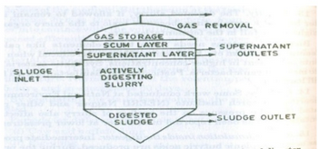
SINGLE STAGE CONTINUOUS PLANT

Slide 18
In double stage process, acidogenic and methanogenic stage are physically separated into two chambers.
Thus, the first stage of acid production is carried out in a separate chamber and only diluted acids are fed into the second chamber where bio-methanation takes place.
However ,the two stage biogas plants are costlier, difficult in operation and maintenance but they produce more gas. These plants are preferred for larger biogas plant system. The important features of continuous type biogas plants are: (i) Gas production is continuous. (ii) Retention period is less (iii) Less problems as compared to batch type. (iv) Small digestion chambers are required

Slide 19
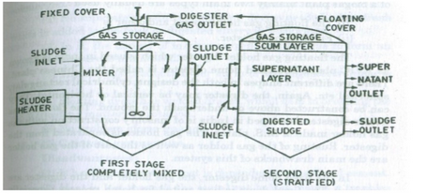
Two stage digestion process

Slide 20
Batch plants
Feeding is between intervals, the plant is emptied once the process of digestion is complete.
Battery of digesters are charged along with lime and urea etc, and allowed to produce gas for 40-50 days.
These are charged and emptied one by one in a synchronous manner which maintains a regular supply of the gas through a common gas holder.
Freshly charged digester is aerated for a few days after which it is closed to atmosphere.
Biogas supply may be utilised after 8-10 days.
Expensive –unless operated on large scale.

Slide 21
Batch plants
Batch plants are filled and then emptied completely after a fixed retention time.
Each design and each fermentation material is suitable for batch filling, but batch plants require high labour input.
As a major disadvantage, their gas-output is not steady.

Slide 22
Continuous plant | Batch plant
Produce gas continuously | Gas production intermittent
Need small digestion chamber | Needs several digestion chamber-continuous gas production
Needs lesser period for digestion | Good for long fibrous materials
Less problems-easier operation | Needs addition of fermented slurry to start digestion process

Slide 23
Floating gas holder digester | Fixed dome digester
Used in India. KVIC-Drum type | Chinese plant. Usually built below the ground level. Janta model-Drumless type.
Gas holder separated from digester | Gas holder and digester are combined. Pressure inside the digester varies as the gas is collected.
Masonry construction with gas holder made of MS plates | Local materials can be used in this construction.
Rusting and cost of gas holder are main drawbacks plant | Best suited for batch process. No serious problems in small plants.

Slide 24
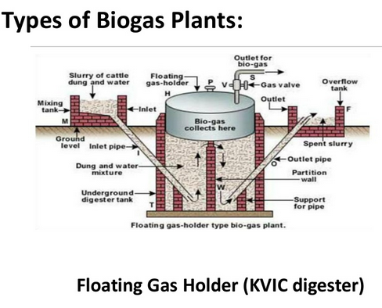

Slide 25
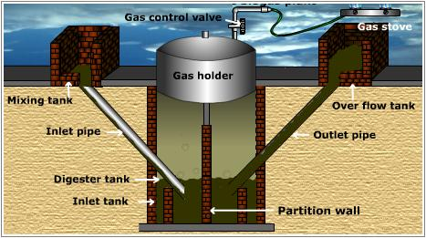

Slide 26
Construction :
The floating gas holder type of biogas plant has the following chambers/ sections:
Mixing Tank - present above the ground level.
Digester tank - Deep underground well-like structure. It is divided into two chambers by a partition wall in between.
It has two long cement pipes: i) Inlet pipe opening into the inlet chamber for introduction of slurry.
ii) Outlet pipe opening into the overflow tank for removal of spent slurry. Gas holder - an inverted steel drum resting above the digester. The drum can move up and down i.e., float over the digester. The gas holder has an outlet at the top which could be connected to gas stoves.
Over flow tank - Present above the ground level.

Slide 27
Working:
Slurry (mixture of equal quantities of biomass and water) is prepared in the mixing tank.
The prepared slurry is fed into the inlet chamber of the digester through the inlet pipe.
The plant is left unused for about 2 months and introduction of more slurry is stopped.
During this period, anaerobic fermentation of biomass -produces biogas in the digester.
Biogas being lighter rises up- starts collecting in the gas holder. The gas holder- moving up. The gas holder cannot rise up beyond a certain level. As more and more gas starts collecting, more pressure begins to be exerted on the slurry.
The spent slurry is now forced into the outlet chamber from the top of the inlet chamber.
When the outlet chamber gets filled with the spent slurry, the excess - outlet pipe into the overflow tank. This is later used as manure for plants.
The gas valve - gas outlet is opened- supply of biogas. continuous supply of gas can be ensured by regular removal of spent slurry and introduction of fresh slurry.

Slide 28
Disadvantages of floating gas holder type biogas plant
Expensive
Steel drum may rust
Requires regular maintenance

Slide 29
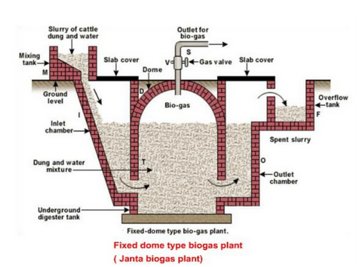

Slide 30
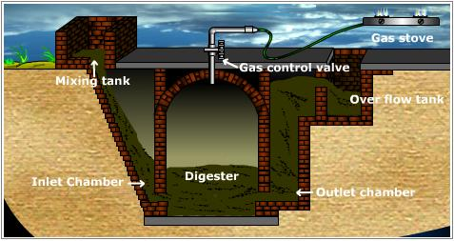

Slide 31
Fixed dome type of biogas plant
The biogas plant is a brick and cement structure having the following five sections:
Mixing tank present above the ground level.
Inlet chamber: The mixing tank opens underground into a sloping inlet chamber.
Digester: The inlet chamber opens from below into the digester which is a huge tank with a dome like ceiling. The ceiling of the digester has an outlet with a valve for the supply of biogas.
Outlet chamber: The digester opens from below into an outlet chamber.
Overflow tank: The outlet chamber opens from the top into a small over flow tank.

Slide 32
Working:
Slurry-biomass are mixed with an equal quantity of water in the mixing tank.
The slurry is fed into the digester through the inlet chamber.
When the digester is partially filled with the slurry-slurry is stopped and the plant is left unused for about 2 months.
During these two months, anaerobic bacteria present in the slurry decomposes or ferments the biomass in the presence of water. As a result of anaerobic fermentation, biogas is formed, which starts collecting in the dome of the digester.
As more and more biogas starts collecting, the pressure exerted by the biogas forces the spent slurry into the outlet chamber. From the outlet chamber, the spent slurry overflows into the overflow tank. The spent slurry is manually removed from the overflow tank used manure.
The gas valve connected to a system of pipelines is opened when a supply of biogas is required.
To obtain a continuous supply of biogas, a functioning plant can be fed continuously -slurry

Slide 33
Advantages of fixed dome type of biogas plant
Requires only locally and easily available materials for construction.
Inexpensive.
Easy to construct

Slide 34
Advantages of biogas as a fuel
High calorific value
Clean fuel
No residue produced
No smoke produced
Non polluting
Economical
Can be supplied through pipe lines
Burns readily - has a convenient ignition temperature

Slide 35
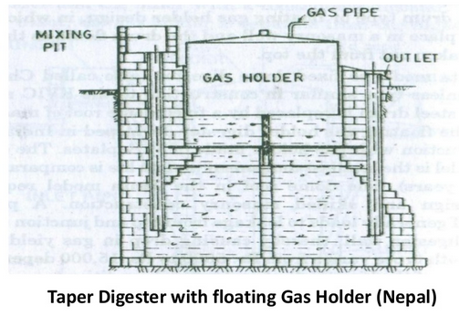

Slide 36
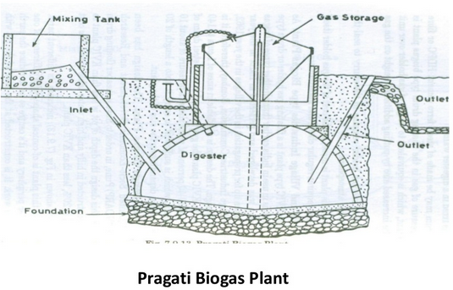

Slide 37
Uses of biogas
Domestic fuel
For street lighting
Generation of electricity
Advantages of biogas plants
Reduces burden on forests and fossil fuels
Produces a clean fuel - helps in controlling air pollution
Provides nutrient rich manure for plants
Controls water pollution by decomposing sewage, animal dung and human excreta.
Limitations of biogas plants
Initial cost of installation of the plant is high.
Number of cattle owned by an average family of farmers is inadequate to feed a biogas plant.

Slide 38
Janta biogas plant
Planning and research action division Lucknow-1978.
Improved version of Chinese fixed dome biogas plant.
Foundation of Janta gas plant is laid at the base of the underground pit on a levelled ground-bear the the load slurry and digester walls.
Digester-cylindrical –with bricks and cement.
It holds the dung slurry for a retention time-biogas is produced.
Diamter:height-1.75:1

Slide 39
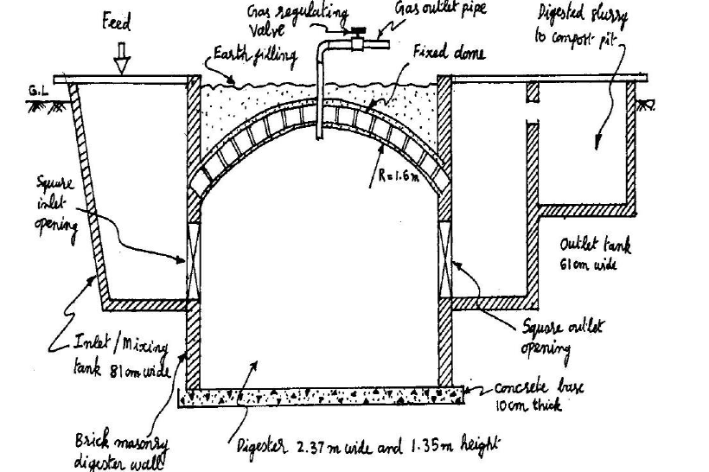

Slide 40
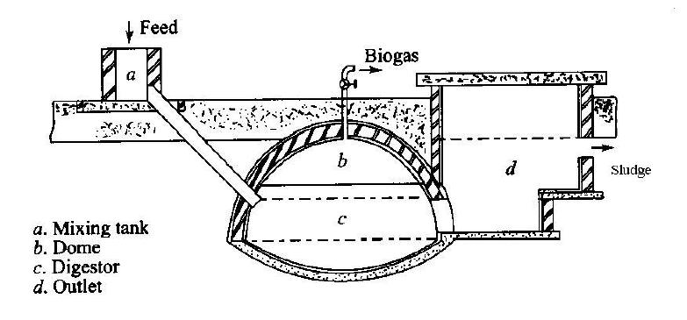
Dheen bandhu biogas plant

Slide 41
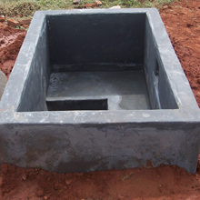
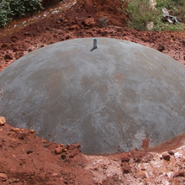
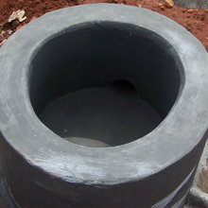

Slide 42
Deenbandhu biogas plant:
Fixed dome plant-Action for food production, New Delhi.
Low cost biogas plant.
Higher compressive strength of the brick masonry and concrete –safe structure.
Asbestos cement pipe-15cm diameter –inlet instead of separate opening.
Pipe is embedded inside the digester wall at a fixed position-opposite to outlet opening.

Slide 43
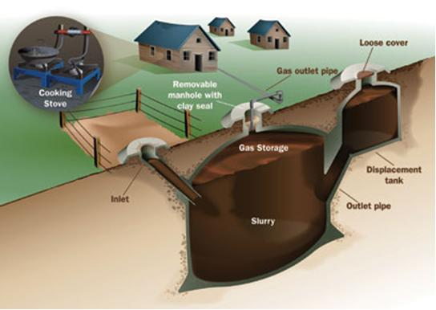
Utilization of biogas for cooking

